Slide 1
Design Principals
Fall 2022
Pei Wang
Department of Statistics

Slide 2
The Importance of Context
Exploratory vs. explanatory analysis
Exploratory Analysis:
The first step of data analysis.
We get familiar with data, ask questions, visualize the data in a number of forms, look for relationships between the variables, look for outliers, patterns and trends in data.
Figure out what might be noteworthy or interesting to highlight to others.
The outputs are only for you.

Slide 3
The Importance of Context
Exploratory vs. explanatory analysis
Explanatory Analysis:
We have identified 1 or 2 interesting observations in the data.
There is a specific thing that we want to explain, a specific story we want to tell.
We now create the visuals to present our findings.
The outputs is generally for the public.
This is the one we will focus in this class.

Slide 4
Things to Think about for Explanatory Analysis
Who
Your Audience:
Be specific, avoid “anyone who might be interested”.
Identify the decision maker.
Think about their needs and expectations.
You:
Your relationship with your audience. First time vs. established relationship.
The relationship impacts the structure, content, order of your communication.

Slide 5
Things to Think about for Explanatory Analysis
What
Action:
What do you need your audience to know or do?
Give some demonstration, recommendation, or encourage discussion.
Mechanism:
What is the method you want to communicate with your audience?
Tone:
What is the tone you want your communication to convey to your audience?

Slide 6
Figure 1.1 Communication mechanism continuum (Storytelling with Data)

Slide 7
Think about for Explanatory Analysis
How
What data is available that will help make my point?
Data becomes supporting evidence of the story you will build and tell.
Construct appropriate visualizations with good design principles that aid in your story.
Nonsupporting data? :
Showing only the data that backs up your point and ignoring the rest is not recommended.
The right amount of context and supporting and opposing data will vary depending on the situation, the level of trust you have with your audience, and other factors.

Slide 8
The 3‐minute story & Big Idea
The idea is you are able to boil the “so‐what” down to a paragraph and, ultimately, to a single, concise statement.
If you had only three minutes to tell your audience what they need to know, what would you say?
What if you want to boil it down to a single sentence?
Components of big ideas (Nancy Duarte (2010)):
It must articulate your unique point of view;
It must convey what’s at stake; ;’
It must be a complete sentence.

Slide 9
Choosing an effective visual
Recognize the characteristics of effective visual.
Analyze different types of visuals and appropriate ways to use them.
Determine how to create original visuals and how to understand the visuals created by others.

Slide 10
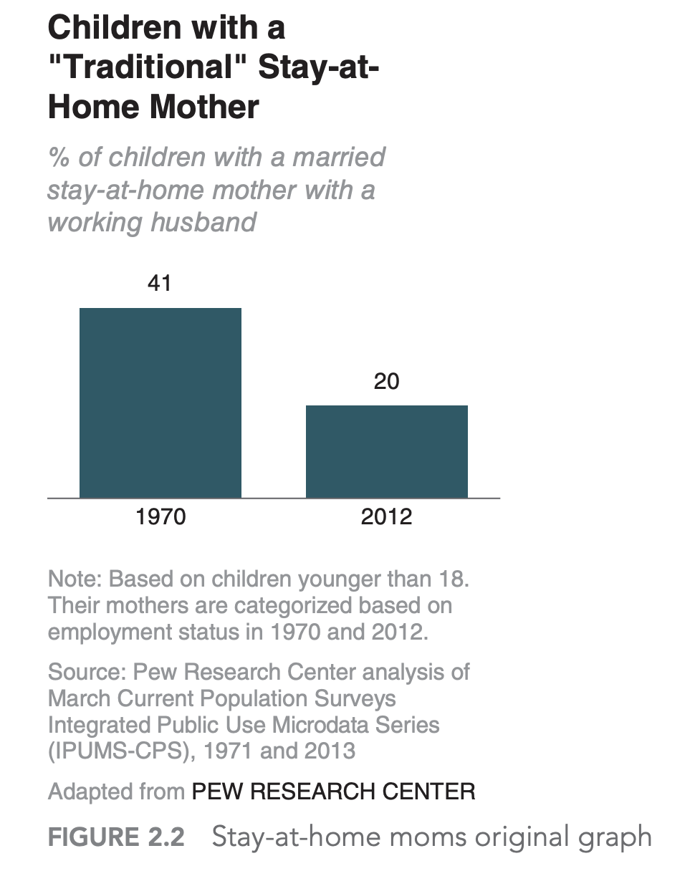
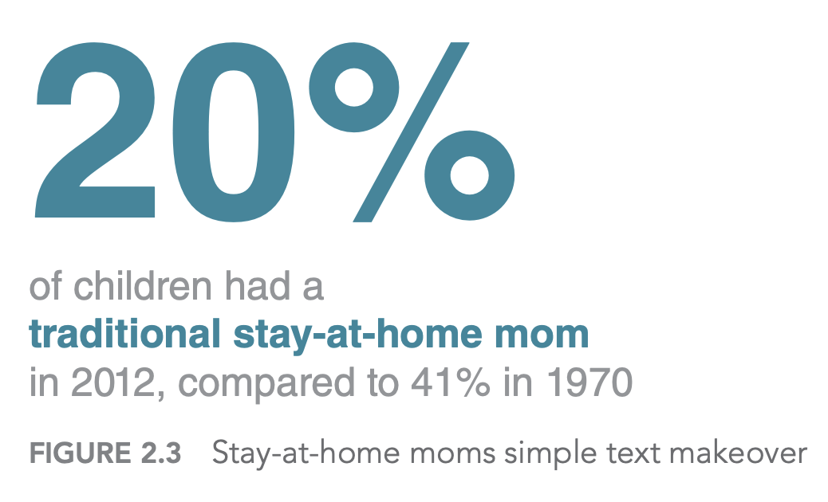
Choosing an effective visual
Simple Text
Tables
Heatmap

Slide 11
Choosing an effective visual
Graphs
Points: Scatter plot
Lines:
Line graph
Slopegraph
Bar:
Vertical/horizontal bar chart
Stacked vertical/horizontal bar chart
Waterfall bar chart
Area
Other types: pie chart, donut chart

Slide 12
Reference
Duarte, N. (2011). Resonate. Soundview Executive Book Summaries.
How America Uses Its Land (Dave Merrill and Lauren Leatherby – Bloomberg, 2018

